Slide 1
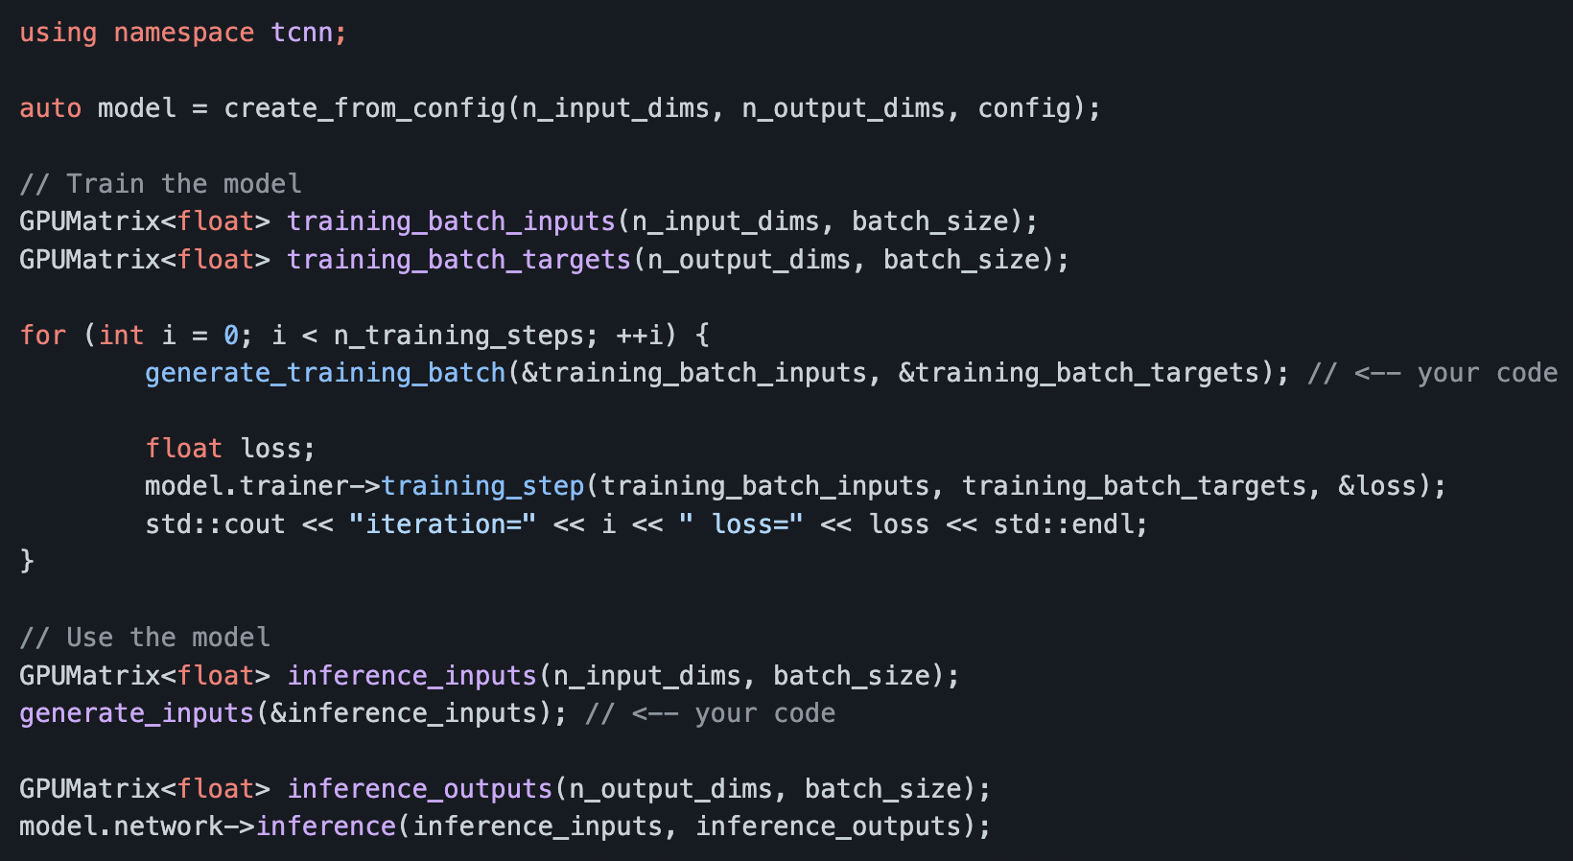

Slide 2
pos encoding
density network
pos
dir encoding
dir
rgb network

Slide 3
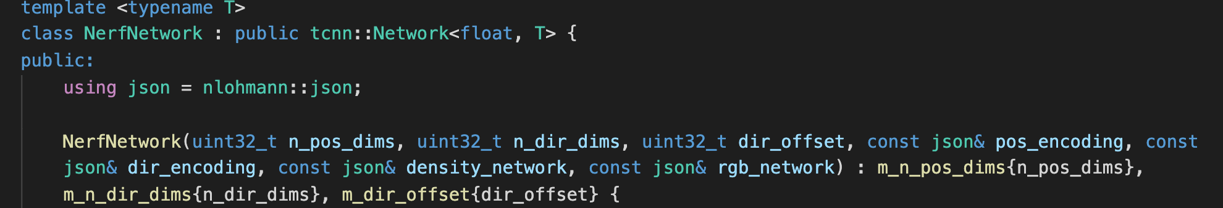
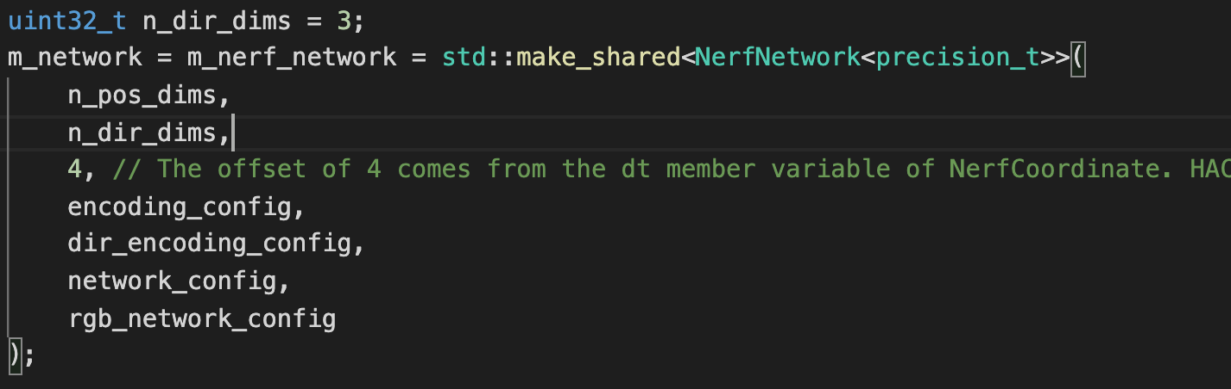
class NerfNetwork

Slide 4
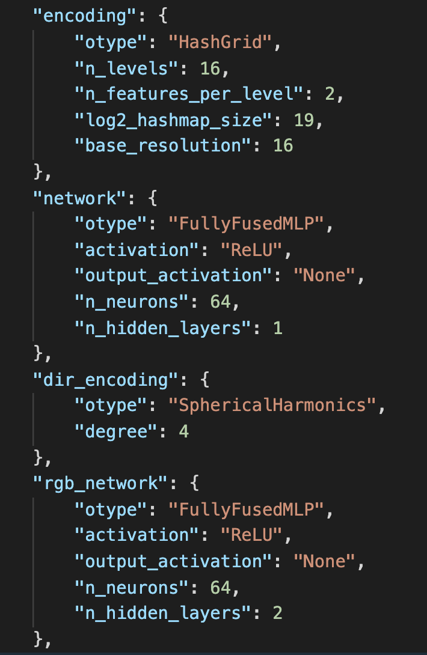
class NerfNetwork

Slide 5
class NerfNetwork

Slide 6
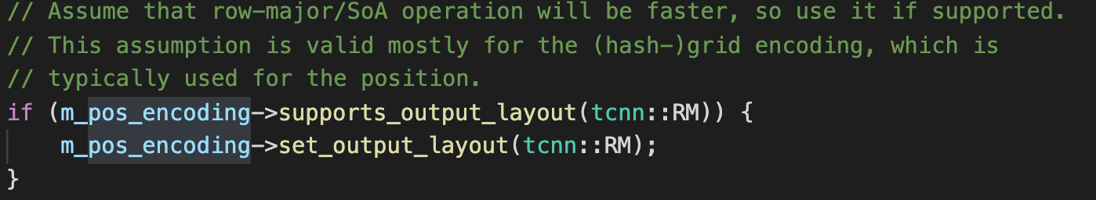
class NerfNetwork

Slide 7
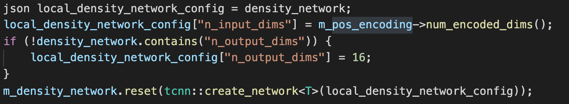
class NerfNetwork

Slide 8
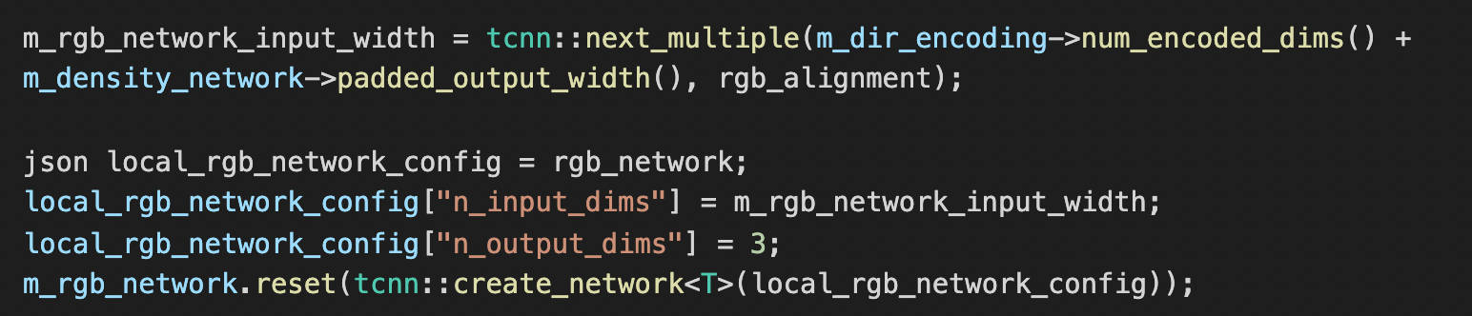
class NerfNetwork

Slide 9
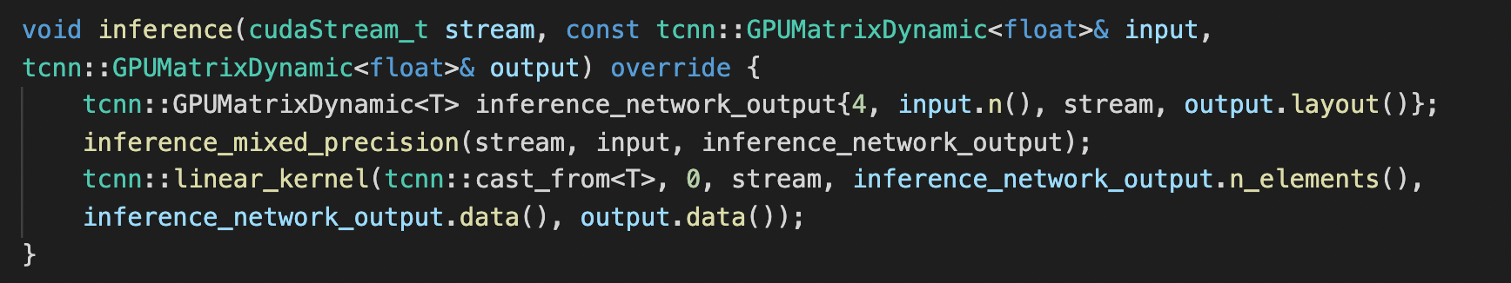
class NerfNetwork inference

Slide 10
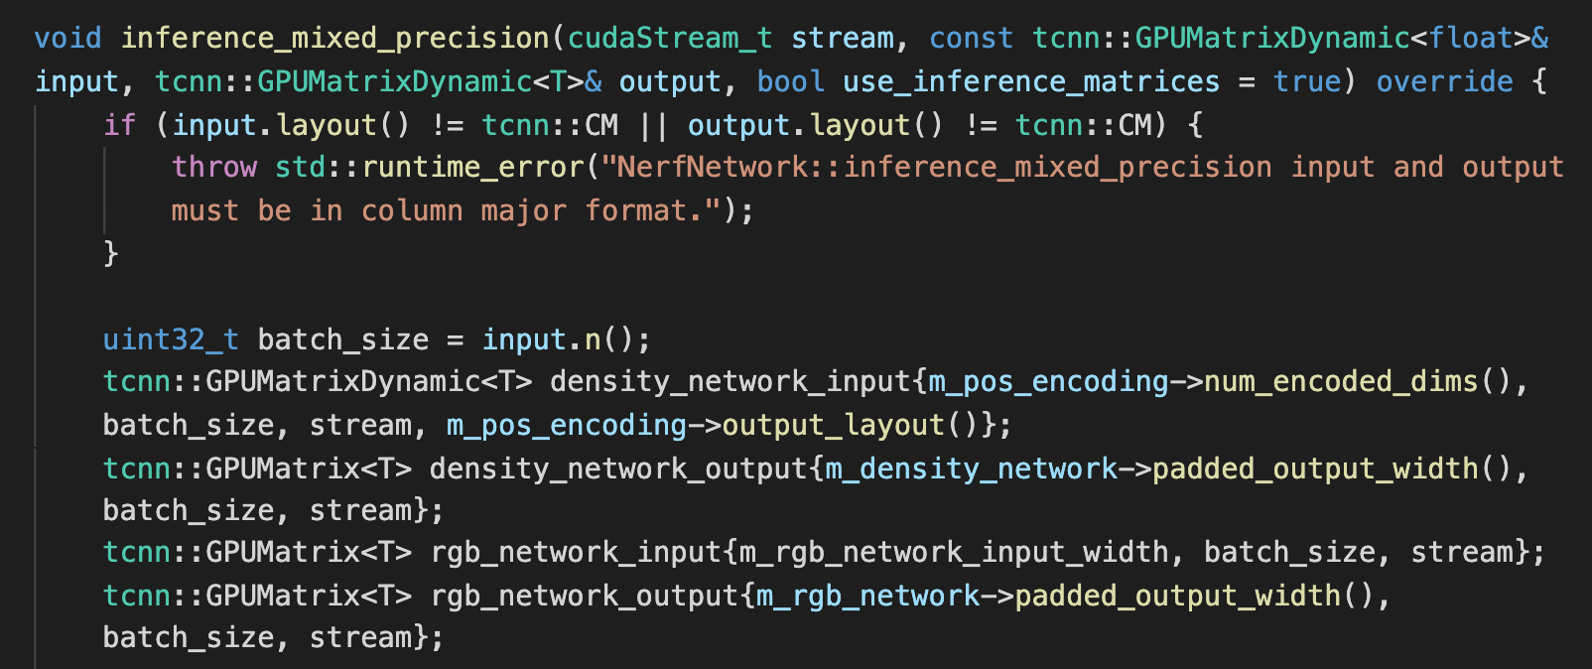
class NerfNetwork inference

Slide 11
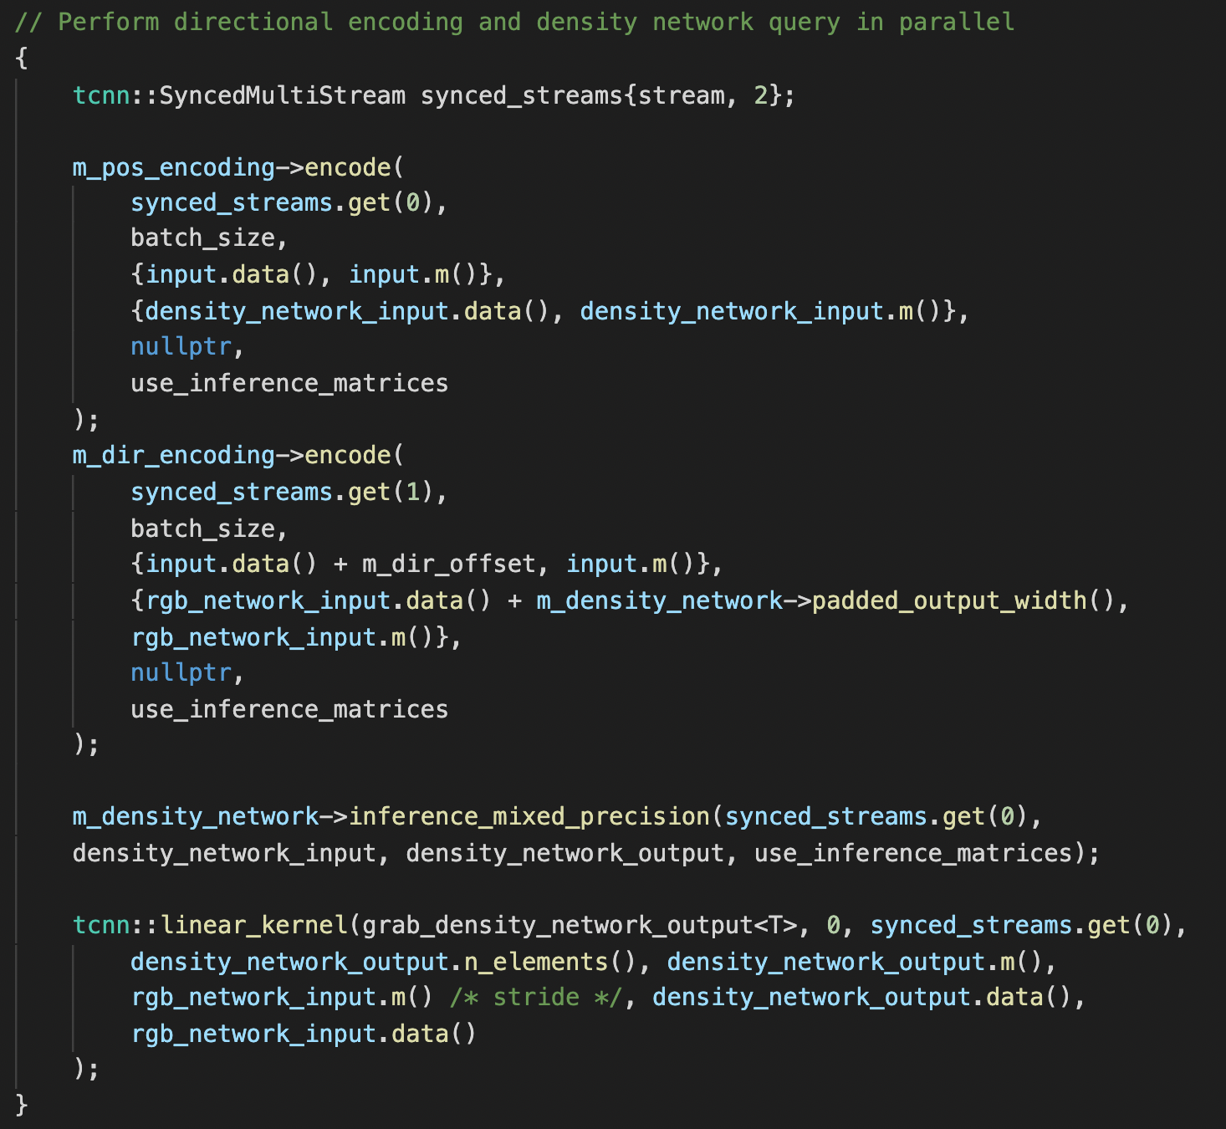
class NerfNetwork inference

Slide 12
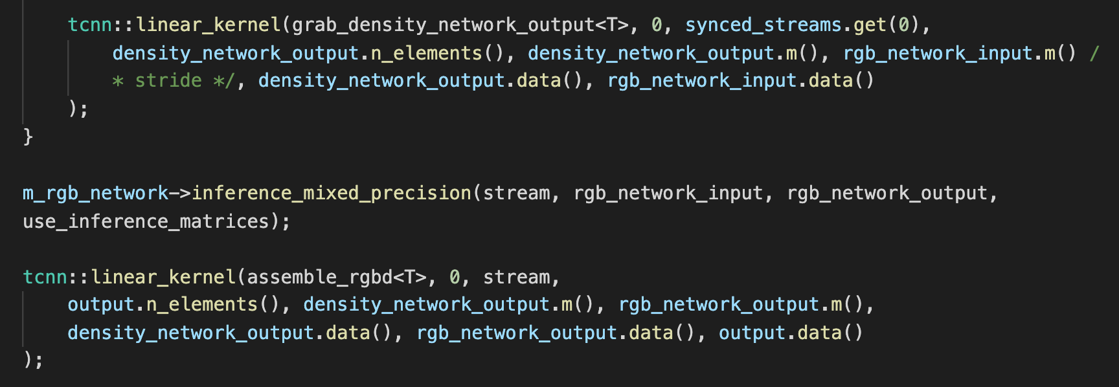
class NerfNetwork inference

Slide 13
pos encoding
density network
16
pos (3)
32
dir encoding
dir (3)
32
rgb network
48
16

Slide 14
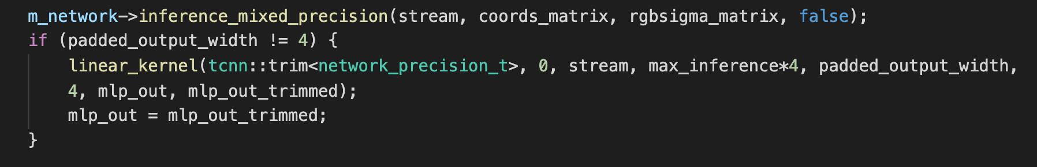
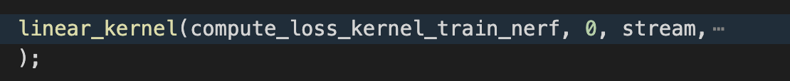
testbed_nerf.cu

Slide 15
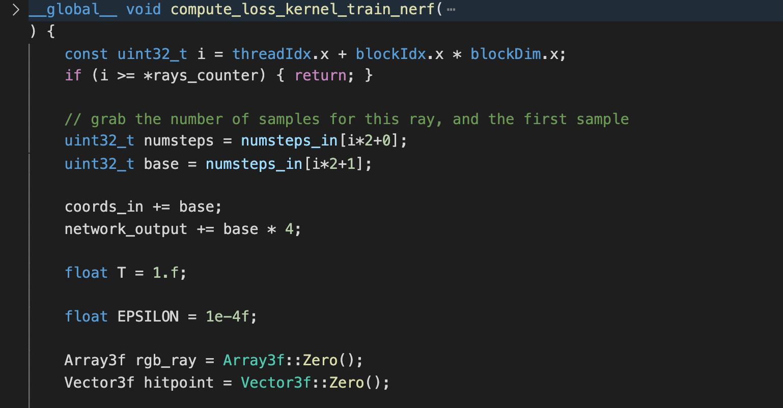
testbed_nerf.cu

Slide 16
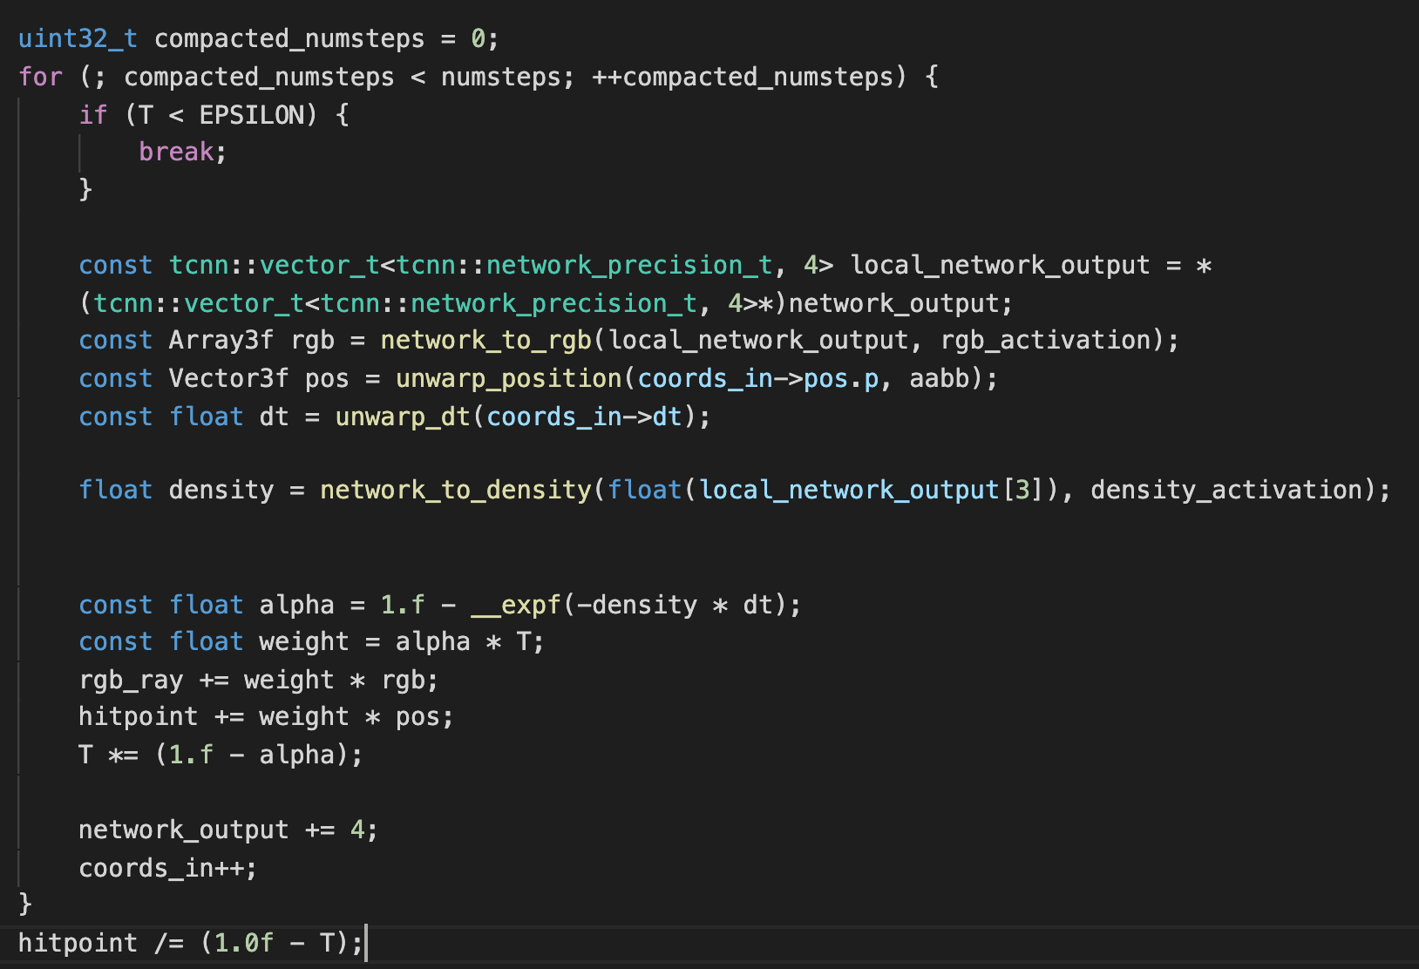
testbed_nerf.cu

Slide 17
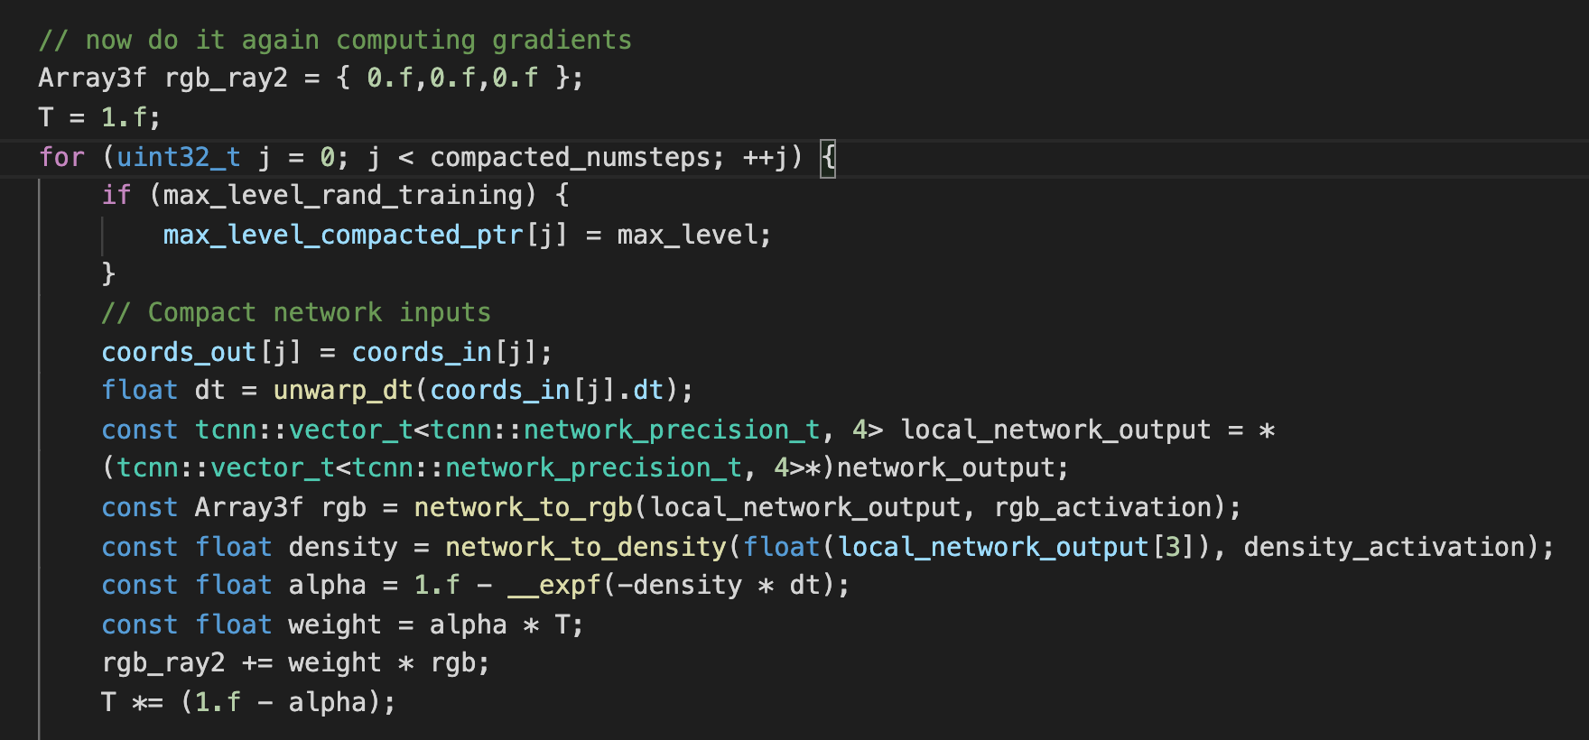
testbed_nerf.cu

Slide 18
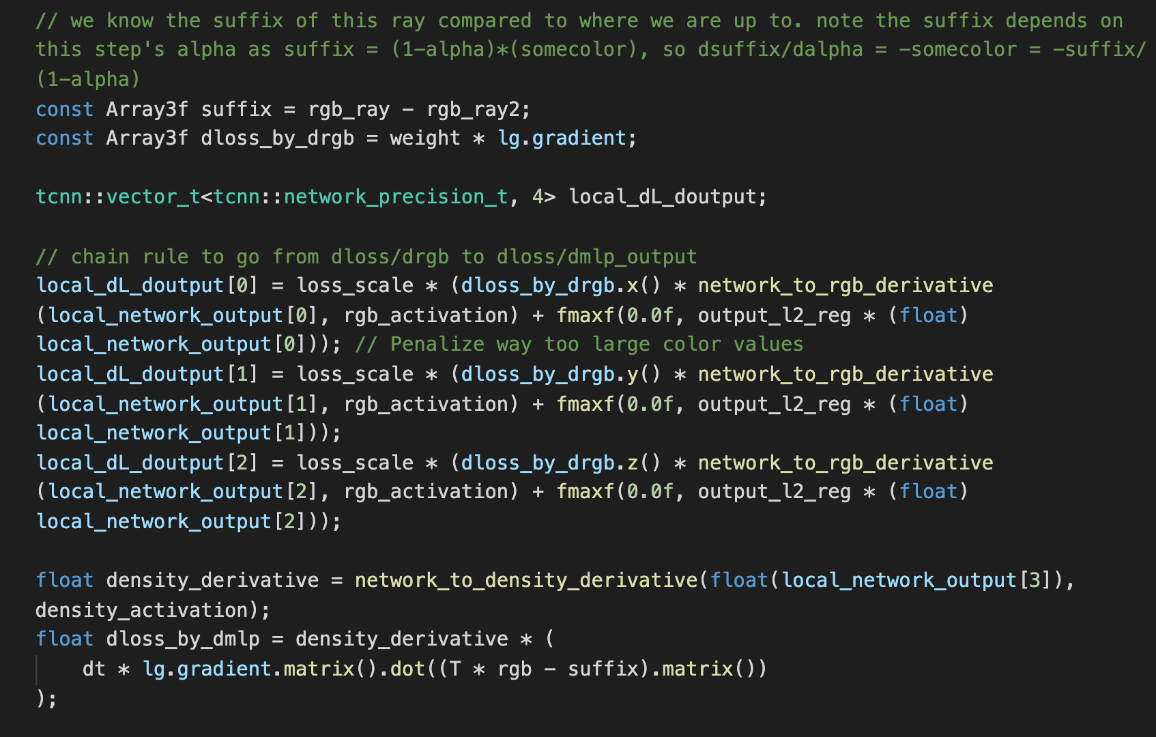
testbed_nerf.cu

Slide 19
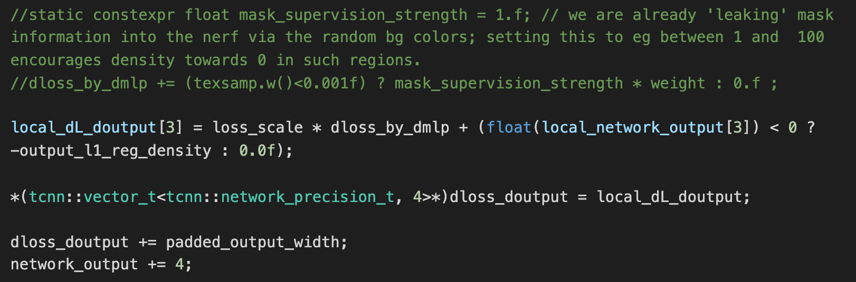
testbed_nerf.cu

Slide 20
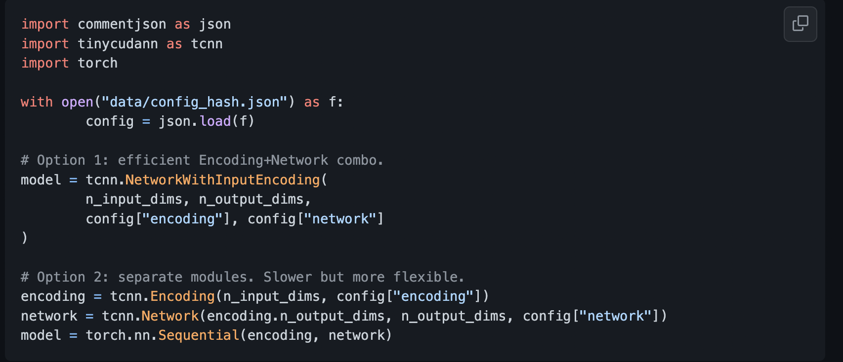
tiny-cuda-nn comes with a PyTorch extension that allows using the fast MLPs and input encodings from within a Python context. These bindings can be significantly faster than full Python implementations; in particular for the multiresolution hash encoding.

